Slide 1
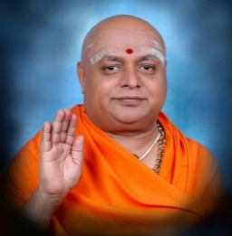
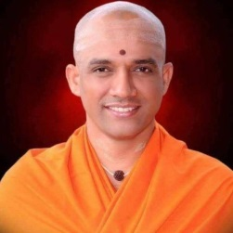
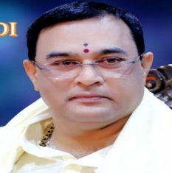
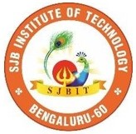
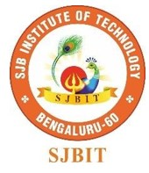

║Jai Sri Gurudev║ Sri AdichunchanagiriShikshana Trust (R) S J B INSTITUTE OF TECHNOLOGY BGS Health & Education City, Kengeri, Bangalore – 60.
Internship Presentation
On
“AGRICULTURE MONITORING SYSTEM USING IoT”
Submitted by
NISCHITHA B [1JB20CS073]
UNDER THE GUIDANCE OF
Internal guide
Mrs. Manjula H S
Assistant Professor
SJBIT
External guide
Mr. Anuz Mohammad
IT Manager
JOAI Pvt. Ltd P-2

Slide 2
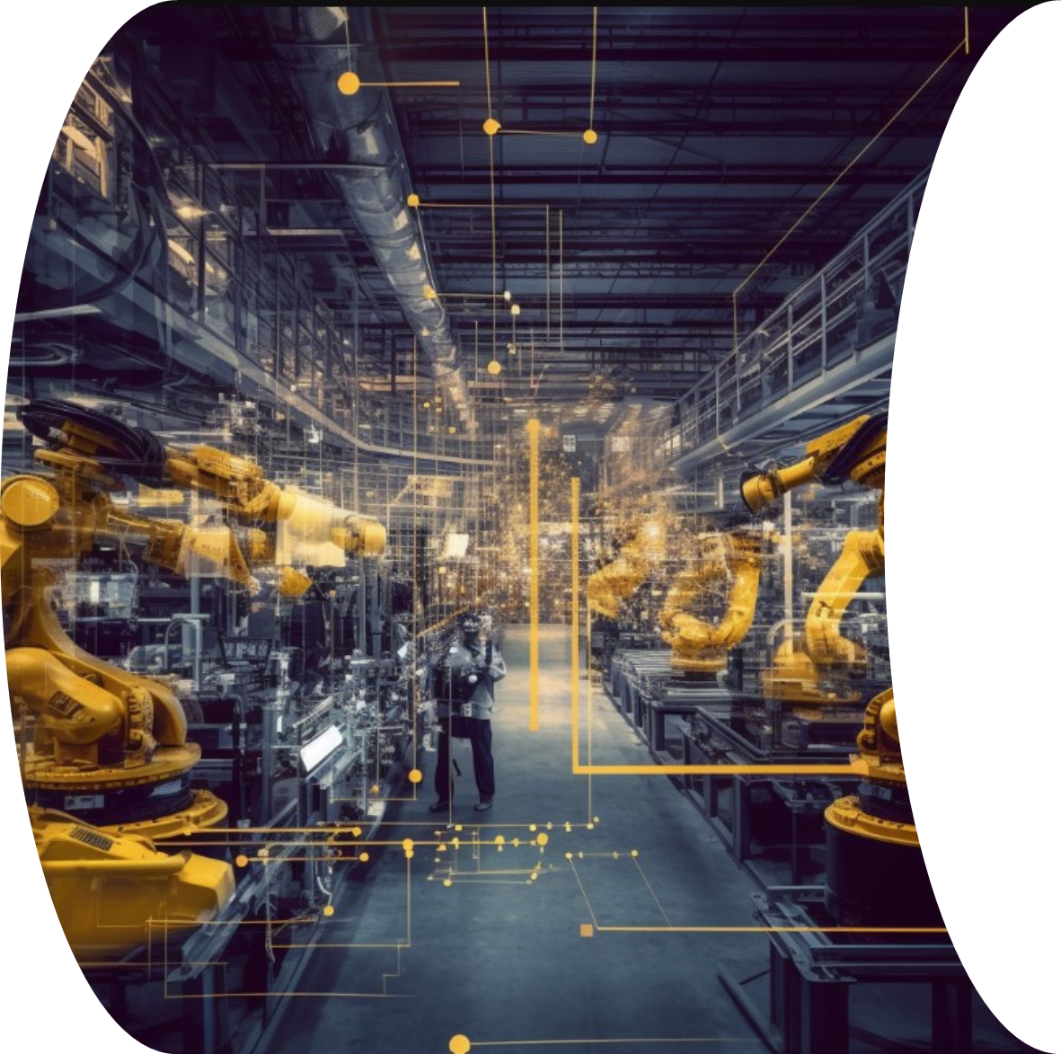

INTERNSHIP

Slide 3
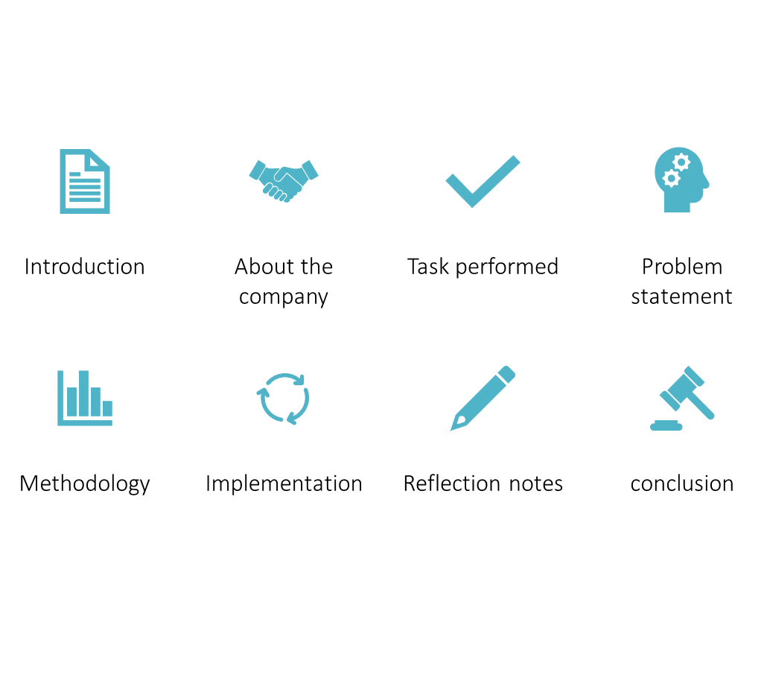
Overview Of Internship Work

Slide 4
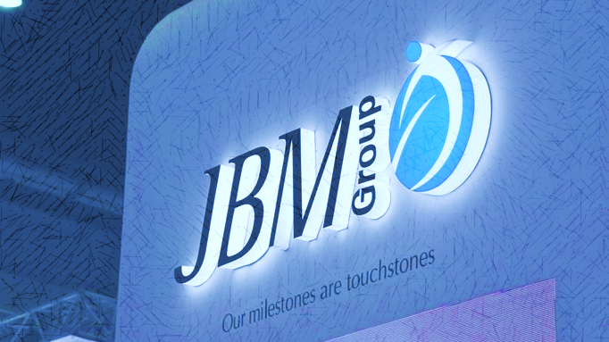
Introduction About the JBM
JBM (Jay Bharat Maruthi) groups journey started nearly four decade ago in 1983.
Founded by S K Arya ,Chairman and Managing Director .
They first started manufacturing cylinders, soon after the technological boon the
founders had a vison “JBM inside”, Inspired by intel concept of “Intel Inside” every
computer, he dreamt of every vehicle manufactured in India having a JBM component inside.
JBM manufactures half a million auto components every day and almost every vehicle manufactured in the country having “JBM Inside”.
JBM company is primarily known for its presence in the automotive components,
sheet metal manufacturing, engineering design, tooling and more.
JBM groups manufacture wide range of automotive components such as chassis system, suspension system , exhaust system, body-in-white system, seating system etc.

Slide 5
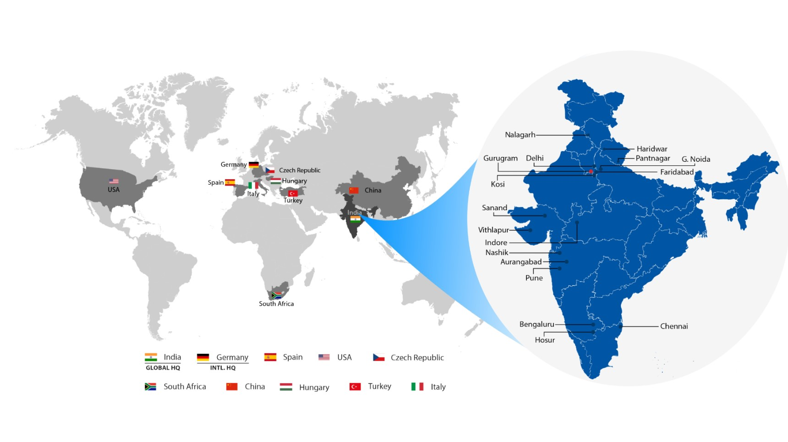
Introduction About the JBM
JBM group is a $2.6bn global conglomerate with a presence in more than 10 countries such as India , USA ,China , Germany , South Africa ,Spain and many more.
In India there are several branches of JBM group each producing different set of components of cars ,they have presence in Bengaluru, Gurugram, Delhi, Chennai, Indore ,Pune and many more.

Slide 6
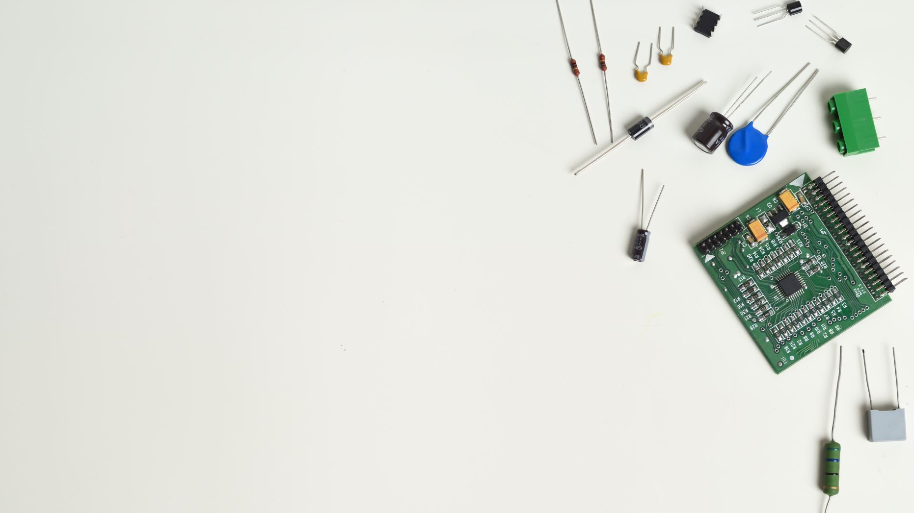
Introduction About the JBM
JBM Services:
JBM Ogihara Automotive India Limited (JOAI) is one of OTC’s 5 Affiliated companies in the oversea countries. JOAI is a Joint Venture company in India between JBM AUTO Limited (JBM) and Ogihara (Thailand) Co., Ltd. (OTC) since November 10, 2008.
JBM has been providing many technical assistances and making many sets of automotive Tools & Dies for JOAI to serve its main client, Toyota Kirloskar Motors Pvt. Ltd. (TKML), Maruti Suzuki India Limited (MSIL).
JOAI’s main products are sheet metal component, welded sub-assemblies and fuel filler assemblies that been supplying to TKML in various types of Toyota model such as Etios, IMV and EFC (Small Low Car).

Slide 7
JBM products
Tail Gate
Exhaust
Bumper Crash Member
Fuel Neck Filler
Banjo Beam
Front Door
Fendor Apron Assembly
Front Floor Assembly Cabin Assembly
Cross Member
Cross Truck Beam
Fender Assembly
Fuel Tank
Hydraulic Tank
Air Tank
Bumper
Fasteners
Body Assembly
Tubes
Pulleys
Long Body Assembly
Frame Assembly
Rear Axle[
Cross Bar Beams
Rear Doors

Slide 8





Nissan
TATA
Toyota
TVS
Volvo-Eicher
Volkswagen and many more.
Renault
Maruti Suzuki
Mahindra
JCB
Hero
Honda
General Motors Corporation
Ford
Fiat
Bajaj Auto Ltd
Ashok Leyland,
JBM CLIENTS
JBM Group comprising primarily of auto component division, caters services to esteemed clients that include .

Slide 9
Task performed
Week 1
Week 2
Week 3
Week 4
Reporting at office with all Photocopies of Documents.
Overview to Company Profile and Total Internship Schedule.
Plant Visit
Introduction on IOT , Private 5G and Mesh Wifi.
Learning components of IOT.
Working with components in line 1 and 2.
Working with components in line 3 and 4.
Discussing ideas about the project.
Introduction to PLC.
Working with robots.
Discussing about project and its problem statement.
Learning project key points.
Research about project.
Implementation of Project.
Testing and Improvising.
Report making
Presentation of Project.

Slide 10

ABOUT THE DEPARTMENT
In today's fast-paced business world, staying at the forefront of technological innovation is paramount for any company striving for success. JBM Company has taken this mantra to heart, with its IT department spearheading a remarkable transformation through the integration of
Biometric systems,
Face detection technology,
Human Machine Interface (HMI)
Internet of Things (IoT) devices .
And many more.
These advancements have not only streamlined operations but also enhanced security, efficiency, and connectivity, positioning JBM Company as a trailblazer in the industry.

Slide 11
INTRODUCTION
Smart agriculture is a farming management concept using modern technology to increase the quantity and quality of agricultural products.
Farmers in the 21st century have access to the modern technologies to use soil scanning, weather report and smart sprinkler irrigation system.
In IOT based smart agriculture, a system is built for monitoring the crop field with the help of sensors ( humidity, temperature, soil moisture, etc.) and automating the irrigation system.

Slide 12
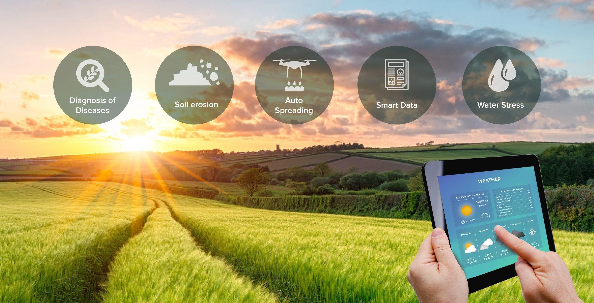
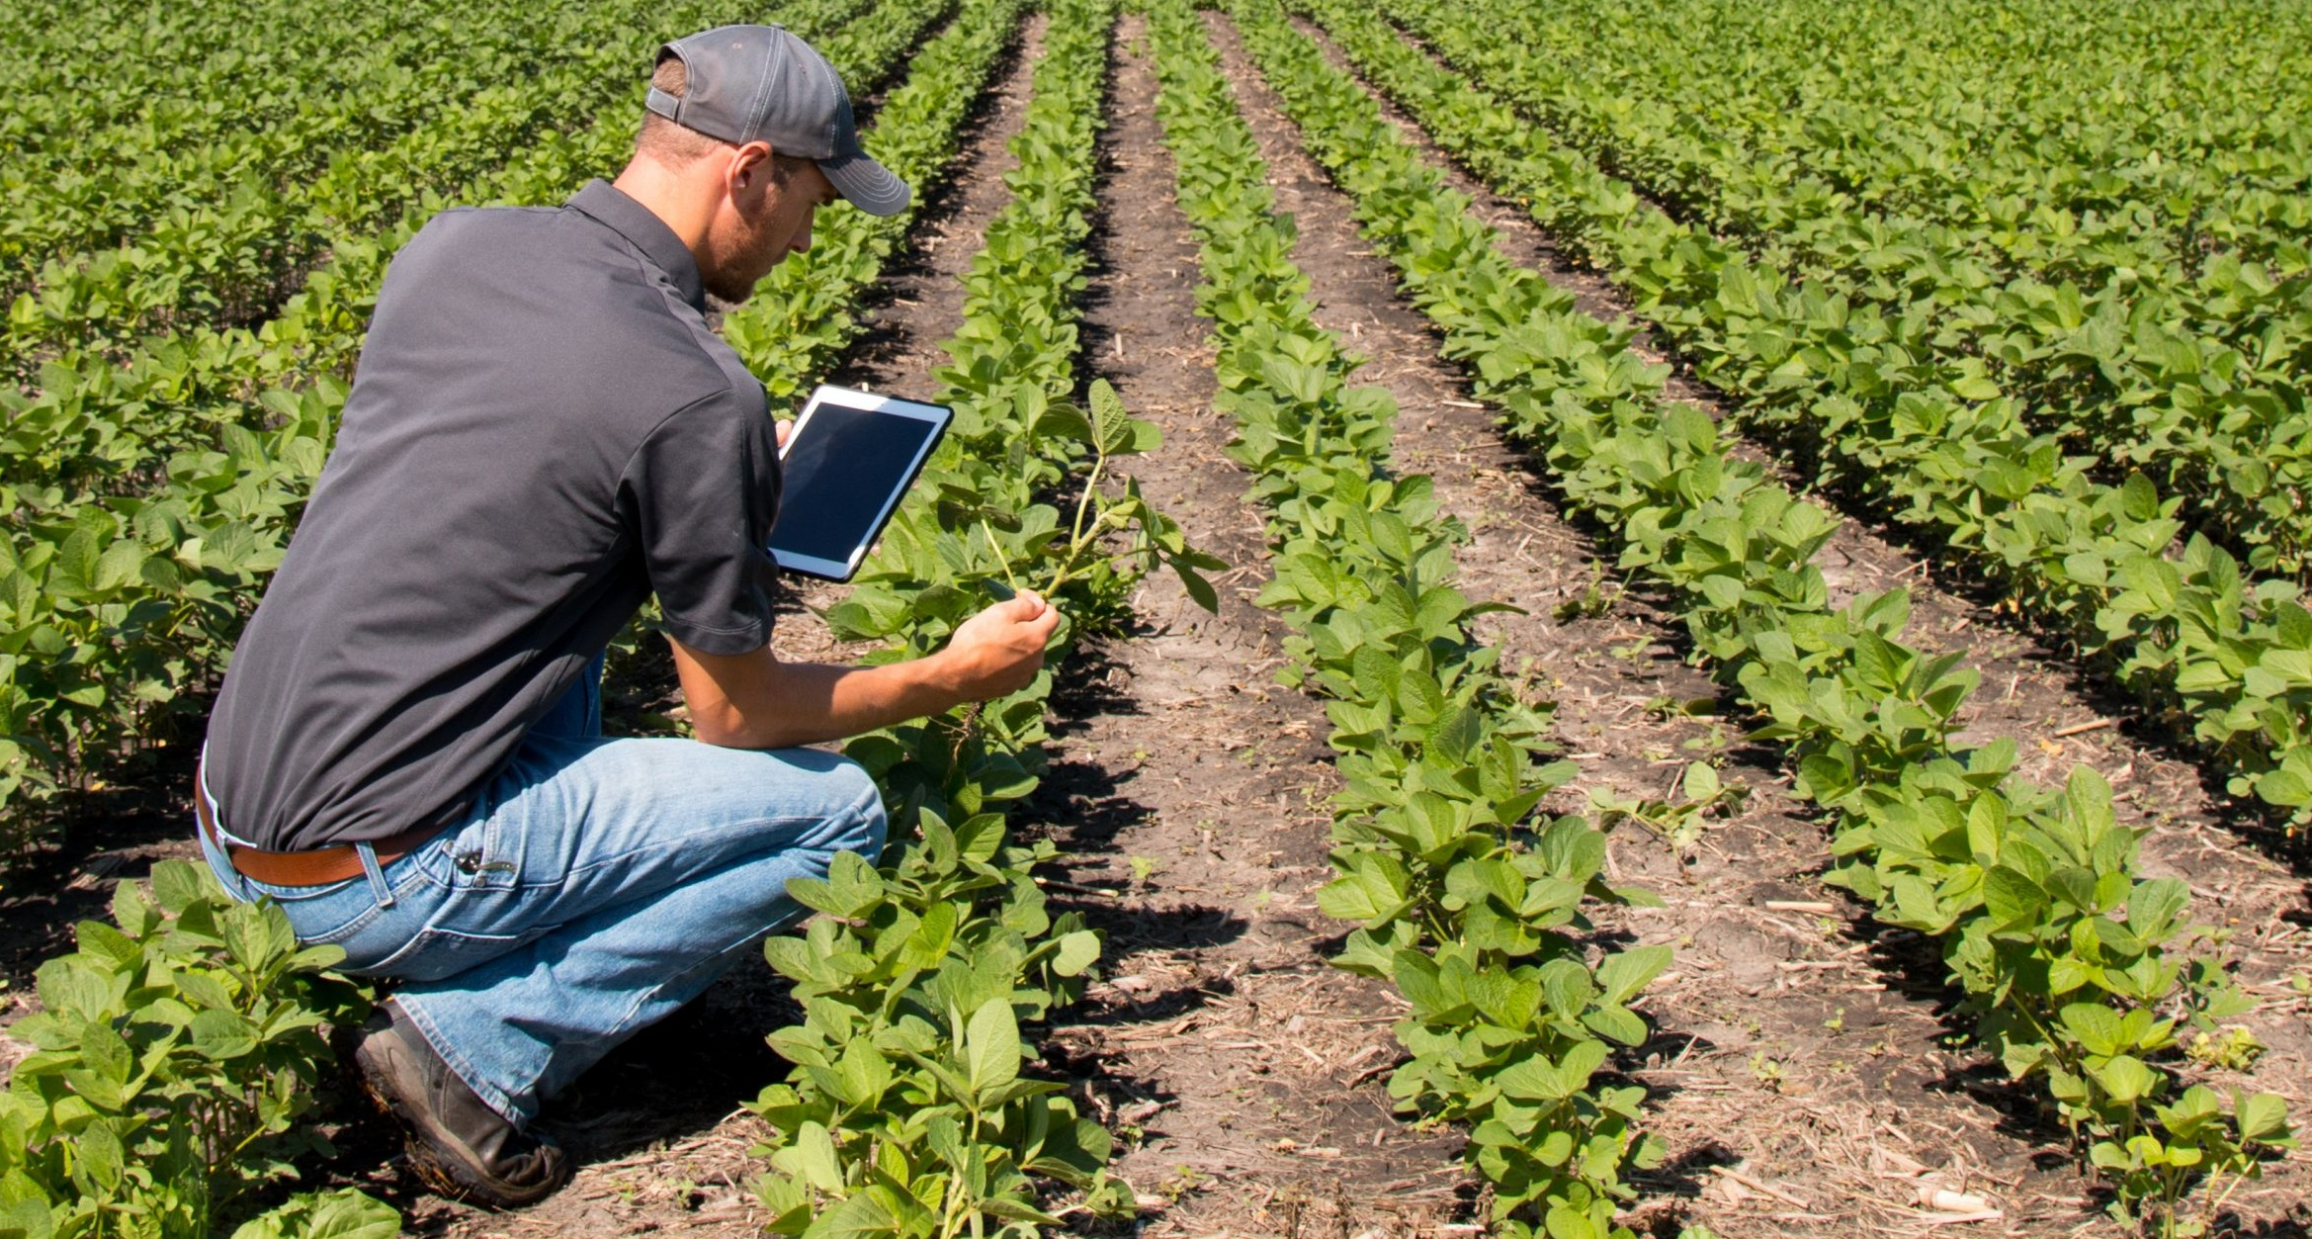
This overcomes the manual operations required to monitor and maintain the agricultural farms in both automatic and manual modes.
It should be able to measure the increase or decrease in level of water as well as moisture in the soil.

Slide 13
Literature survey
1.Controlled sprinkler irrigation system for agricultural plant cultivation
Abstract -In recent decades, precision agriculture and smart farming have become promising issues particularly in the industrial revolution era 4.0. The main objective of this presented paper is to apply the optimized controlling system developed by means of Internet of things for controlling sprinkler irrigation systems used for agricultural product cultivation where in this study.
Implementation and discussion-The implementation of the system here includes the implementation of the main construction, implementation of hardware and implementation of software. The implementation of the main construction is a sprinkler irrigation network made using components such as pumps, reservoirs , main pipes, lateral pipes, and sprinklers.
The hardware implementation, namely a series of bulk irrigation control devices, is assembled on a breadboard that is connected to the Arduino Uno board. The task of this series of irrigation control devices is to receive data and then send it back to the application that is used to be displayed on a smartphone.
The results displayed become a reference in the controlling process for the bulk irrigation. The schematic of data sender and data receiver.

Slide 14
2. Smart Agriculture System IOT
Abstract- India being an agrarian’s country, Mostly Indian farming are dependent on rains, soil, dampness and environment challenges .Our farmers upgraded to modern state of art technology in cultivation. Globally the IoT systems has contributed its application in many fields and proven to be successful. It is the time that Indian farmer need to introduce the Smart Agricultural systems for higher crop yield. The productivity with compilation of data from sensors, actuators and modern electronic gadgets the farmer can monitor agricultural fields.
Implementation and discussion- Wireless Sensor network in the process of development in smart and precision agriculture can be used to monitor regularly the changes in environmental conditions such as climate, humidity, temperature, rains dampness of soil and others.
As a process input, it can also demonstrate as a controller in the providing the inputs for seeds, fertilizers, pesticides etc.
The WSN application shall aid the data collection process to for information needed by the farmers for cultivation and also as Input feeder control system on agricultural machinery.
The failures and breakdown issues such as malfunction of sensor and power supply related issues and also the information security may be an area of concern in the Wireless Sensor networking systems.

Slide 15
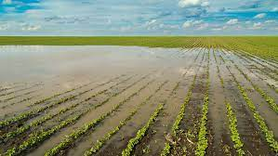
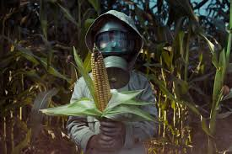
PROBLEM STATEMENT
Water source is necessary and an important factor in agricultural and farm production . Monitoring water level of a water source plays a key role in agriculture.
Manual release of water sometimes leads to overflow of water in the field which spoils the crops and the crop field Release of excessive amount of pesticides is very much harmful for the plants and crops, by which the crops are effected by less growth or get diseased.
Due to the weather condition, water level increasing Farmers get lot of distractions which is not good for Agriculture. Performing agriculture manually is very much time consuming.

Slide 16
OBJECTIVES
To collect and store the dataset.
To read the moisture level of the soil using sensors and to output the results to the farmers device.
To develop an application which controls the flow of water and release pesticides.
To generate the weather report on the same applications.
To reduce workload of farmers.

Slide 17
METHODOLOGY
Methodology of objective-1: To measure the moisture level of the soil we’ll place moisture sensors in different parts of the field.
Methodology of objective-2: The data will be sent to the output device and the farmer can decide to release adequate amount of water depending upon the crop and soil moisture level.
Methodology of objective-3:The program to measure water level and release water will be return using a set of programming language codes and libraries.
Methodology of objective-4The Arduino will allow us to connect the device application to real time data which the sensors obtain from the field.

Slide 18
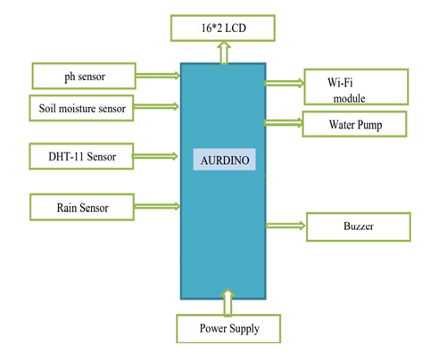
BLOCK DIAGRAM

Slide 19
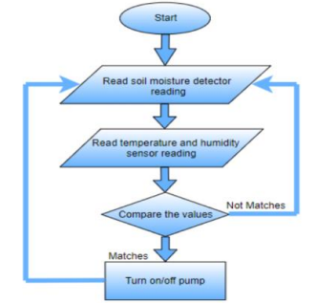
DESIGN

Slide 20
TECHNOLOGY AND TOOLS USED
Software and Hardware Requirements
Moisture Sensors and Temperature Sensors
Arduino
Water Pump
Microcontroller

Slide 21
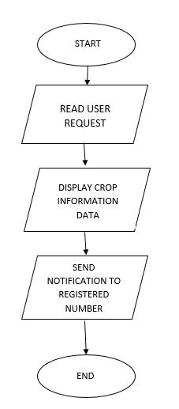
IMPLEMENTATION

Slide 22
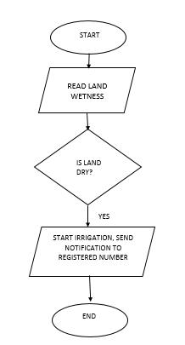

Slide 23
What is ‘ARDUINO’?
It’s intended for students, artists,designers,hobbyists and anyone who tinker with technology.
It is programmed in Arduino Programming language(APL) similar to C/C++.
Way more easy to program compared to other microcontroller packages.
The Arduino is a microcontroller development platform
It is the winner of “worlds best interaction award 2012” sponsered by google

Slide 24
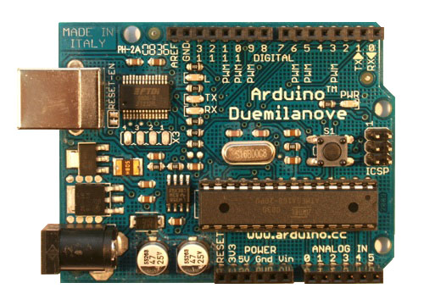
Arduino UNO
Pin 13 LED
Digital pins header
USB connector
Reset button
ATmega328 MCU
Barrel jack
Analog pins header
Power-ground header
http://arduino.cc/en/uploads/Main/ArduinoDuemilanove.jpg

Slide 25

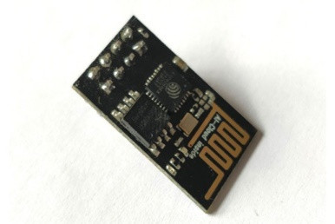
COMPONENTS USED:
ARDUINO UNO
The Arduino Uno is an open-source microcontroller board.
The board is equipped with sets of digital and analog input/output (I/O) pin.
It can be powered by the USB cable or by an external 9-volt battery.
ESP8266
The ESP8266 is a very user friendly and low cost device.
The module can work both as a Access point (can create hotspot) and as a station (can connect to Wi-Fi).
It can also fetch data from internet using API’s.
Wi-Fi module used to get the input from the smart phones.
It updates the each operation executed during the automatic condition.

Slide 26
Rain Fall Sensor
Comparator output signal clean wave good driving ability,
The Rain Sensor Detector Can Detect Raindrops Water, So It Can Be Used For Detection Systems That Perform Functions Required When It Begins To Rain.
Output: Digital switching output (0 and 1)
Small board pcb dimensions: 3.2cm x 1.4cm, power indicator light, the output signal led indicating lamp, rated voltage and 3.3v-5v

Slide 27
LCD DISPLAY
An LCD is a small low, cost display.
It is easy to interface with a micro-controller because of an
embedded controller
This controller is standard across many displays which means many micro-controllers have libraries that make displaying messages as easy as a single line of code
It offers high flexibility to users

Slide 28
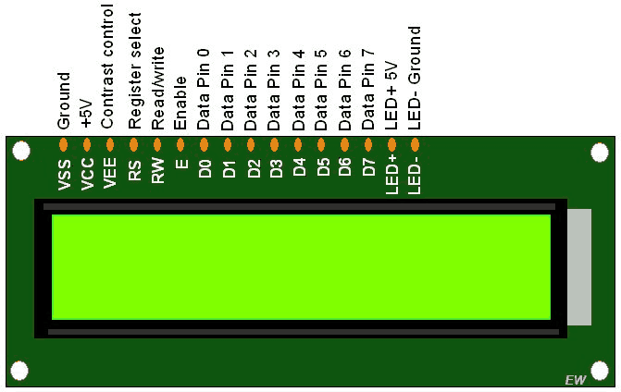
LCD
It is a thin, flat panel used for electronically displaying LCD 16x2 Interfacing with Arduino UNO
information such as text, images and moving picture.
Operating voltage is 5v.
Operating current is 1.2 to 3mA.
Uses of LCD:
easily programmable.
Lightweight
have no limitation of displaying special & even custom
characters (unlike in seven segments),animations and so on.

Slide 29
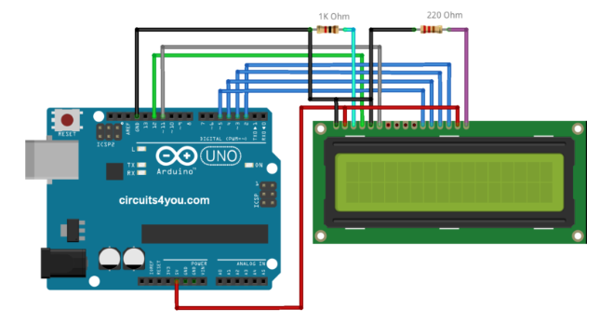
Arduino LCD interfaciNg

Slide 30
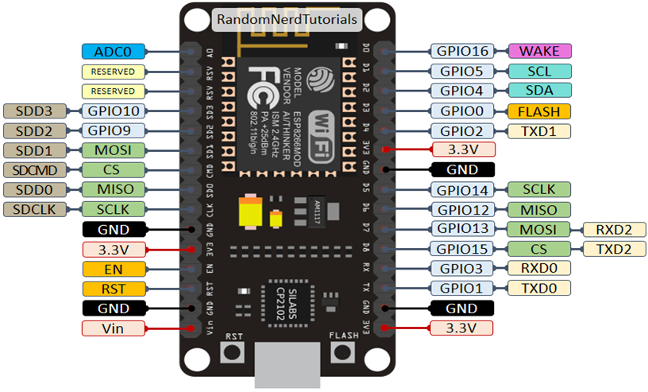
WORK DONE
ESP8266 NodeMCU
NodeMCU is an open source platform based on ESP8266 which can connect objects and let data transfer using the Wi-Fi protocol.
In addition, by providing some of the most important features of microcontrollers such as GPIO, PWM, ADC etc.
The NodeMCU is used to simplify communication as it has inbuilt Wi-Fi module.
Specifications:
Operating voltage : 3.3V
Clock Speed: 80 MHz
Digital I/O Pins: 16
Analog Input Pins: 1

Slide 31
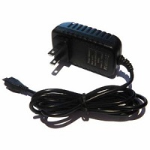
POWER SUPPLY
Micro DC 3-6V Micro Submersible Pump Mini water pump For Fountain Garden Mini water circulation System DIY project. This is a low cost, small size Submersible Pump Motor which can be operated from a 3 ~ 6V power supply.
It can take up to 120 liters per hour with very low current consumption of 220mA. Just connect tube pipe to the motor outlet, submerge it in water and power it.
Make sure that the water level is always higher than the motor. Dry run may damage the motor due to heating and it will also produce noise.

Slide 32
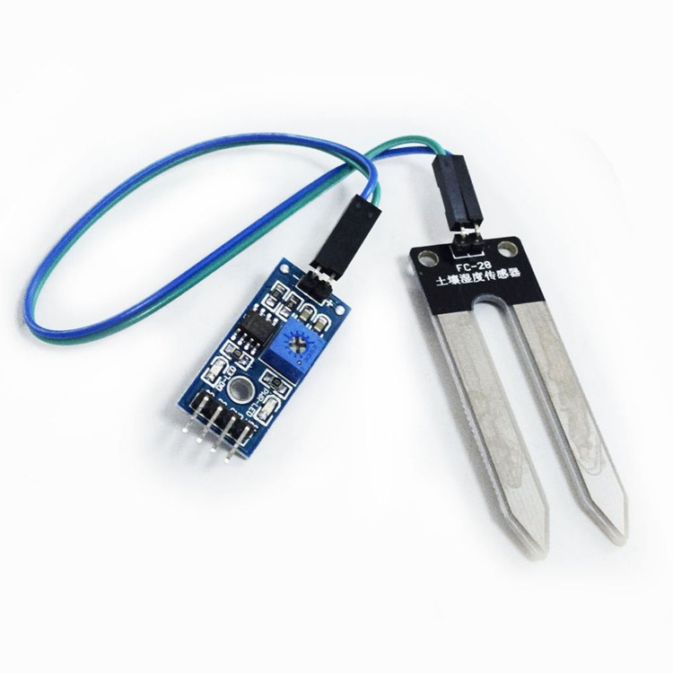
Moisture Sensor
The Moisture sensor is used to measure the water content(moisture)of soil.
When the soil is having water shortage ,the module output is at high level, else the output is at low level.
This sensor reminds the user to water their plants and also monitors the moisture content of soil.
Working Voltage:5V
Working Current:<20mA
Interface type:Analog

Slide 33
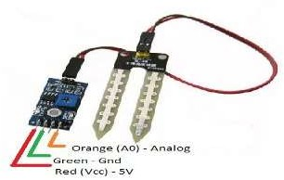
Moisture sensor
soil moisture sensor can be used to test the moisture of soil
measure the volumetric water content in soil.
Soil moisture content may be determined via its effect on dielectric constant by measuring the capacitance between two electrodes implanted in the soil.
Working Temperature:10°C~30°C

Slide 34
LCD Display
LCD is used in a project to visualize the output.
16x2 LCD is used in project which indicates 16 columns and 2 rows. So, total 32 characters we can display on 16x2 LCD.
It can also use in a project to display the pesticide name to be spray on the crops.

Slide 35
SOFTWARE DESCRIPTION
FEATURES OF C
It is modular
Lowers development time
Lowers debugging time
Better portability
Architecture of the system
need not be known

Slide 36
Embedded C
EMBEDDED C
Individual bits can be accessed
Data is taken from external devices.Hence no need of standard i/o functions.
We use char data type to save memory
It is platform specific unlike C
Instead of<stdio.h>,we use <LPC214A.h>which enables the compiler to include the architecture of the controller

Slide 37


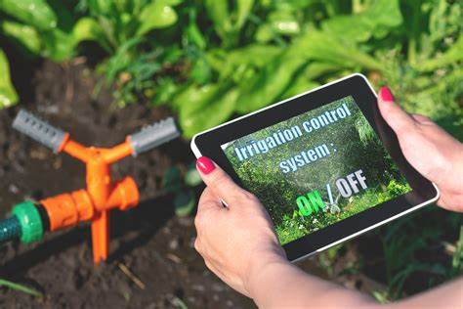
Outcomes of this project
PROJECT OUTCOMES
This project has implemented in the point of agriculture aspects.
The outcomes are:
The moisture sensor senses the soil moisture continuously if the soil humidity descends for it's fixed range it will notify the owner and on the water pump to keep soil moisture constant.
The rain sensor senses the air humidity if it has more possible to rain then it will keep the water pump hold even if the soil moisture is less..
The moisture sensor senses the soil moisture continuously if the soil humidity descends for it's fixed range it will notify the owner and on the water pump to keep soil moisture constant.
The rain sensor senses the air humidity if it has more possible to rain then it will keep the water pump hold even if the soil moisture is less.

Slide 38
CONCLUSION AND FUTURE ENHANCEMENTS
CONCLUSION:
To develop a android application based on smart irrigation which help us to monitor moisture, temperature and irrigate if the moisture level is below. The project presents the use of correct soil moisture sensors which helps to ease out the pain to monitor and keep records about the changes in soil moisture and release of equal amount of pesticides for the crops. The amount of water required for the crops varies from one crop to another. We use types of crops which require more and less amount of water ,the android developed helps in equal amount of water distribution depending upon the crop type
FUTURE ENHANCEMENTS:
One of the greatest advantages of a smart irrigation system is its ability to save water. Generally speaking, traditional watering methods can waste as much as 50% of the water used due to inefficiencies in irrigation, evaporation and overwatering.
By measuring conditions in the field, and feeding this data back to the farmer, their proposed system would enable farmers to make informed, data-driven decisions about when to irrigate and, equally importantly, when to turn the taps off. The result would be better for the plants and the planet.

Slide 39
REFERENCES
www.proquest.compubidlinkhandler/sng/pubtitle/IOP+Conference+Series.+Earth+and+Environmental+Science/$N/4998669/PagePdf/2607343508/fulltextPDF/5C1D9927EB754B81PQ.
www.proquest.compubidlinkhandler/sng/pubtitle/IOP+Conference+Series.+Materials+Science+and+Engineering/$N/4998670/PagePdf/2535635614/fulltextPDF/5C1D9927EB754B81PQ.
https.proquest.compubidlinkhandler/sng/pubtitle/Water/$N/2032318/PagePdf/2110057104/fulltextPDF/5C1D9927EB754B81PQ/48.
https:.researchgate.net/publication/347563621_Smart_Agriculture_System_using_IoT_Technology_Publisher_International_Journal_of_Advance_Research_in_Science_and_Engineering_2020.
https://www.irjet.net/archives/V7/i7/IRJET-V7I7479.2020smart agriculture irrigation system IOT 2020.

Slide 40
THANK YOU

